Slide 1
First World Problems
FRESH OFF THE BUTAW
Bagamaspad | Caingles | Panganiban | Simeon

Slide 2


Slide 3
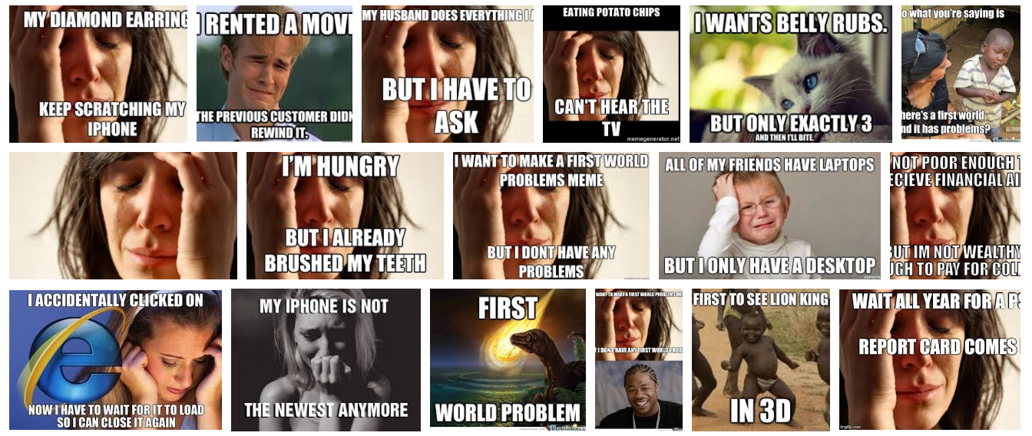

Slide 4


Slide 5
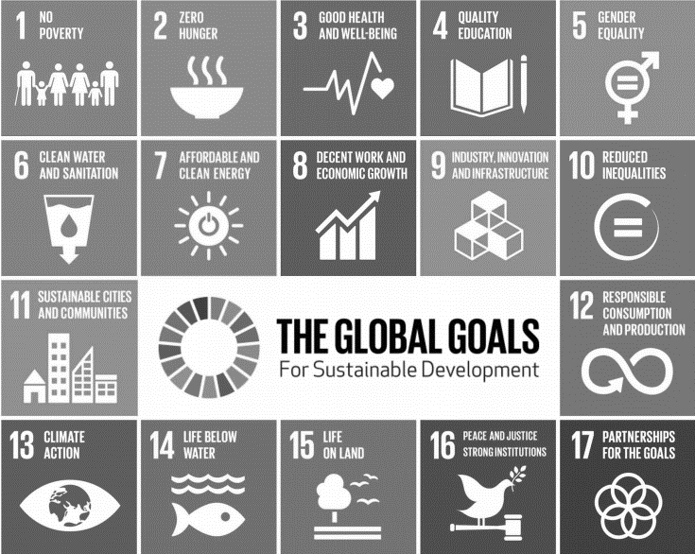







Slide 6
¯\_(ツ)_/¯

Slide 7


Slide 8


